Slide 1
PCFG Independence Assumptions

Slide 2
PCFGs and Independence
The symbols in a PCFG define independence assumptions:
At any node, the material inside that node is independent of the material outside that node, given the label of that node
Any information that statistically connects behavior inside and outside a node must flow through that node’s label
S
S → NP VP
NP → DT NN
NP
NP
VP

Slide 3
Non-Independence I
The independence assumptions of a PCFG are often too strong
Example: the expansion of an NP is highly dependent on the parent of the NP (i.e., subjects vs. objects)
All NPs
NPs under S
NPs under VP
Notes:
This is a more general fact. Not a fact about particular headwords.

Slide 4
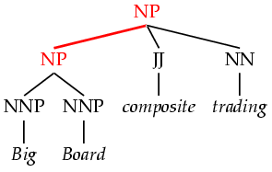
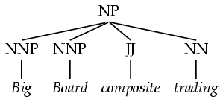
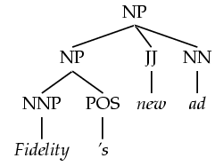
Non-Independence II
Symptoms of overly strong assumptions:
Rewrites get used where they don’t belong
In the PTB, this construction is for possessives

Slide 5
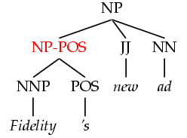
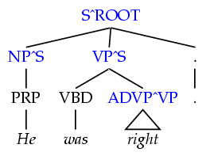
Refining the Grammar Symbols
We can relax independence assumptions by encoding dependencies into the PCFG symbols, by state splitting:
Too much state-splitting ➔ sparseness (no smoothing used!)
What are the most useful features to encode?
Parent annotation
[Johnson 98]
Marking possessive NPs
Notes:
- Annotations split the grammar categories into sub-categories.
- Conditioning on history vs. annotating
P(NP^S → PRP) is a lot like P(NP → PRP | S)
P(NP-POS → NNP POS) isn’t history conditioning.
- Feature grammars (unification-based grammars) vs. annotation
Can think of a symbol like NP^NP-POS as NP [parent:NP, +POS]
- After parsing with an annotated grammar, the annotations are then stripped for evaluation.

Slide 6
PCFG Independence Assumptions

